Slide 1


Challenge: Sensor Based Token Obtainer
Luis Wyss, Lukas Schmid, Darrell Morgan, Samuel Kummer, Daniel Knechtle, Benedikt Spindler…

Slide 2
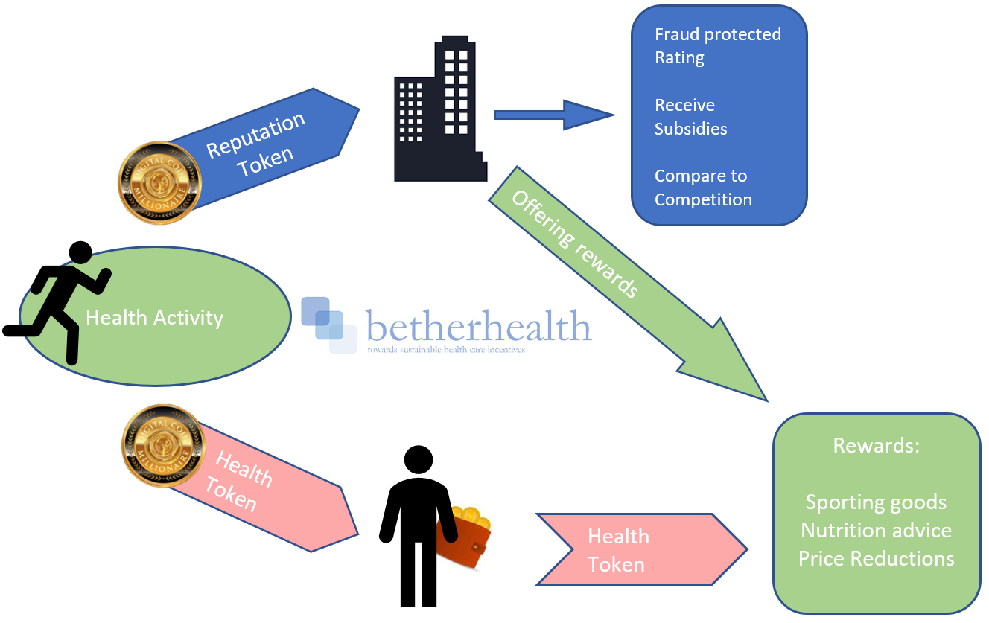
Our social challenge:
Our Solution: Rewarding a healthy lifestyle with a 2 Token economy
Initiate the transition from treatment towards prevention of illness
Reduce health care cost associated with problems prevented by a healthy lifestyle
Health token:
- obtained weekly after proving your healthy activity
- used to claim rewards offered by the insurance aiming at a healthy lifestyle
Reputation Token:
- accumulated by the insurance company for every token earned by their insurance subscriber
- Resenting activity level of the insured and standing of the company compared to competitors

Slide 3

Outcome:
Changes from before:
Promoting a healthier lifestyle
Easier access to activities/goods/services which are beneficial to health through the reward system
Natural Contest and Excitement around healthy activities
Create a fraud-protected rating for the insurance
Create a proof of concept to build upon
Healthcare system is centered around prevention not treatment
More choice for customers, more differentiation potential for insurances
Insurance company does not receive your tracker data

Slide 4
Questions to be discussed…
and potential ideas for the future
How can we make the system less vulnerable to cheating on the users end while still maintaining data security?
additional verification for actions
include accredited gyms, where activity is encouraged and also monitored.
How can the system be used in applications outside of insurance companies?
community based token economy
wider reward structure
How can we include the disabled and immobile into our reward system?
alternative ways to gain token, healthy food etc
Participate in sponsored activities, such as wheelchair basketball, etc
There is a lot of untapped potential regarding this application, but a 2 token system has the power to create an environment where a healthy lifestyle is not only encouraged, but incentivized, thus disrupting the normalities of healthcare insurance.

Slide 5
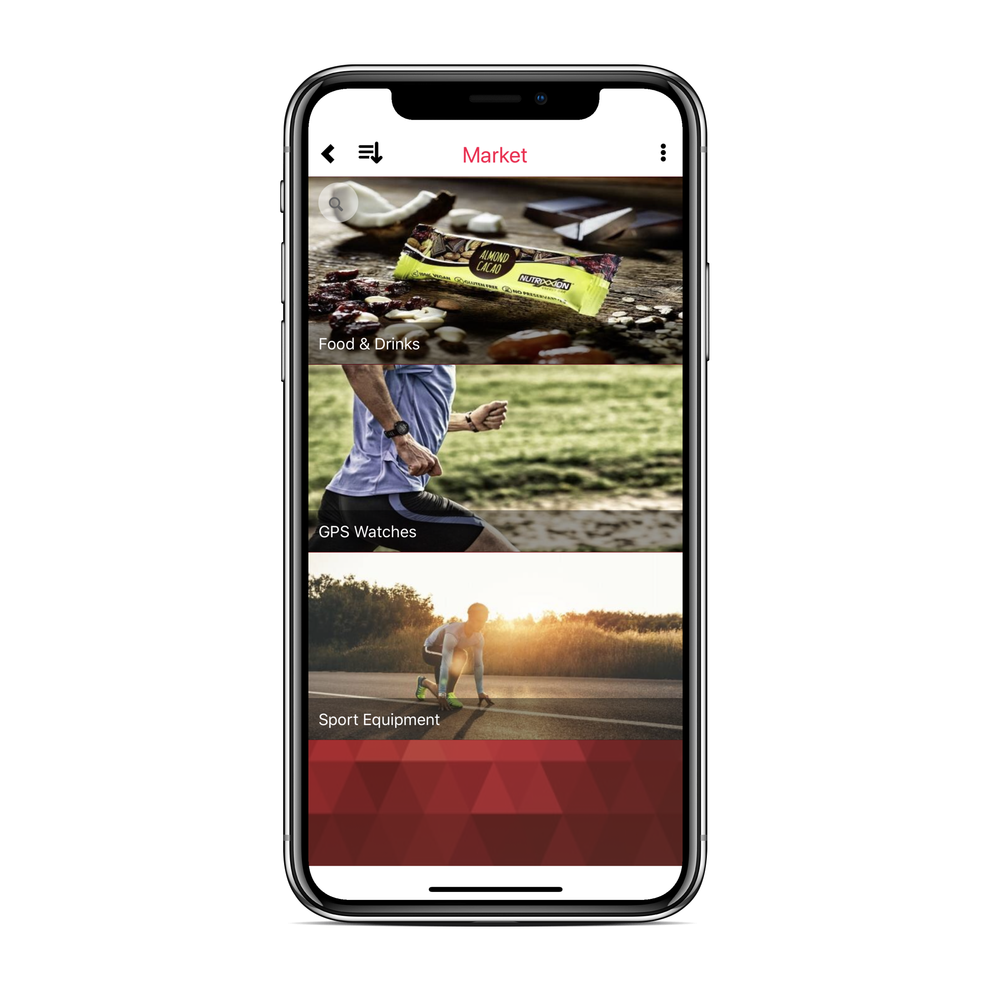
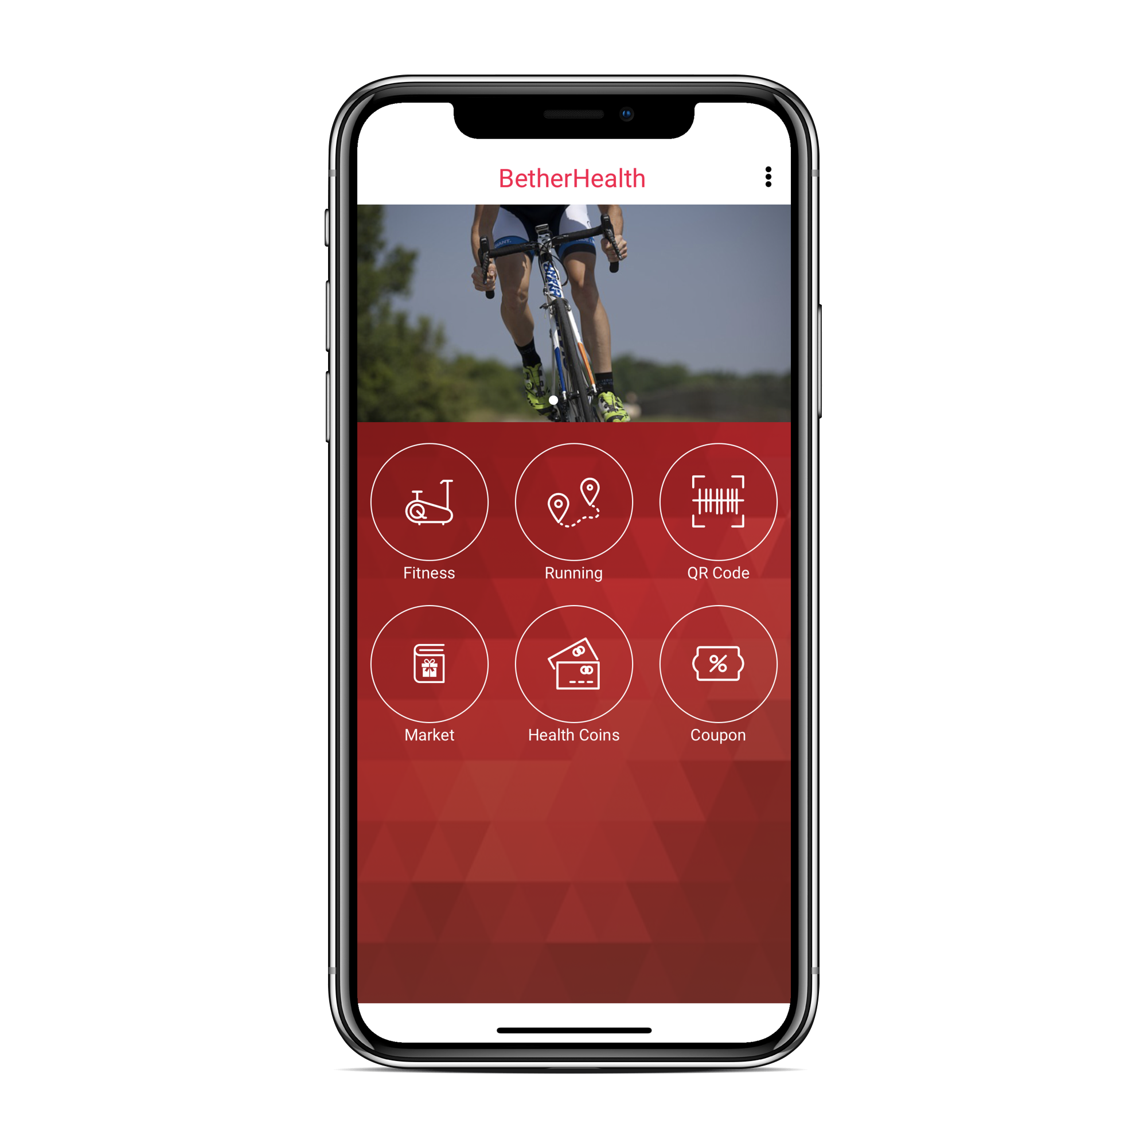
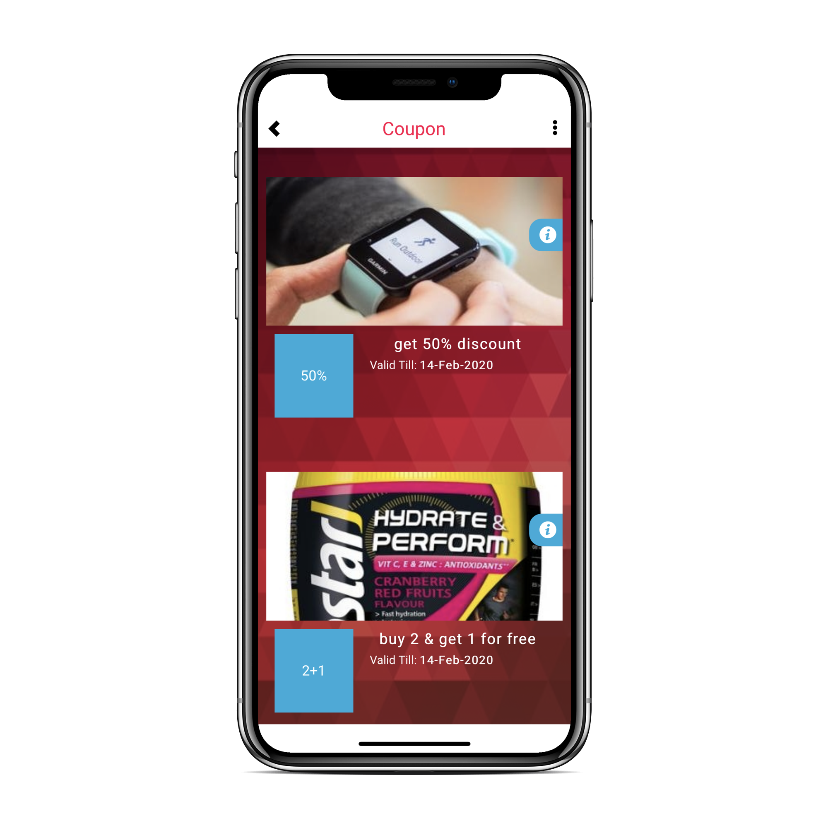
reward categories
simple interface
choose your reward

